Slide 1
Complexity Analysis of Algorithms: Third Attack!
Obtaining exact complexity functions are tedious and not necessary
In fact, for large values of input size, the highest order of the complexity function dominates the whole function
We can ignore the lower orders of the function
Using the concept of “order” we “classify” algorithms based on their higher orders

Slide 2
Example
f(n) = 5n²+100n+20
We say that f(n) is an order of n²

Slide 3
Big O
Big O notation describes how the runtime or resource usage of an algorithm grows as the input size increases.
It focuses on the asymptotic behavior, meaning it tells us what happens for very large input sizes.

Slide 4
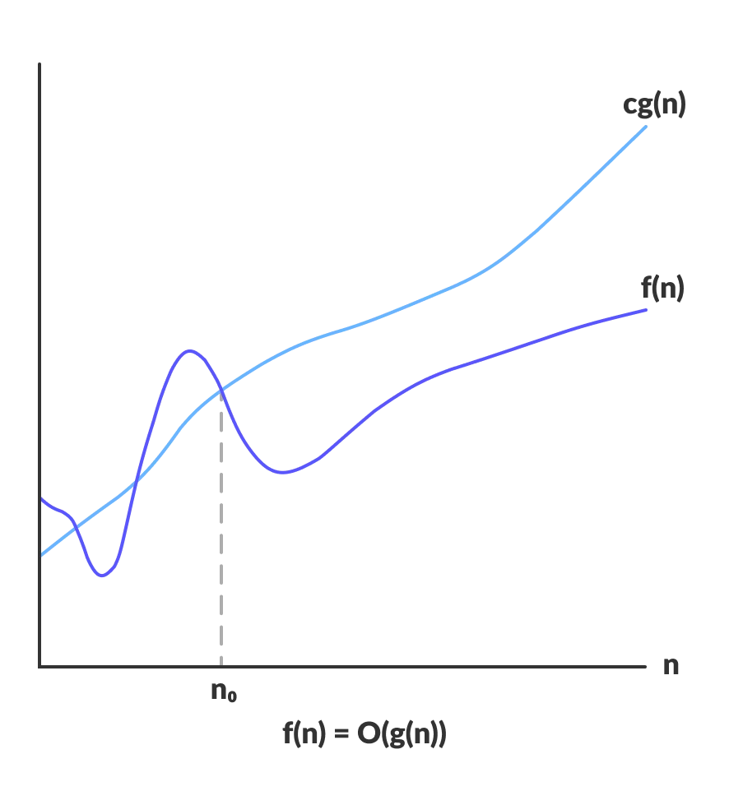
Formal Definition of Big O
Suppose f(n) and g(n) are two functions. f(n)=O(g(n)) if and only if there exist constants k and c that f(n) ≤ cg(n) for all n≥k
We can say that f(n) is at least as good as g(n) or they are asymptotically equivalent.
k

Slide 5
Example
Example: f(n)=n² + 10n
We claim f(n)=O(n²)
To support our claim, we should find c and k that f(n)≤ cn² for all n≥k
Assume c=2 and k=10, then we have n² + 10n ≤ 2 n²

Slide 6
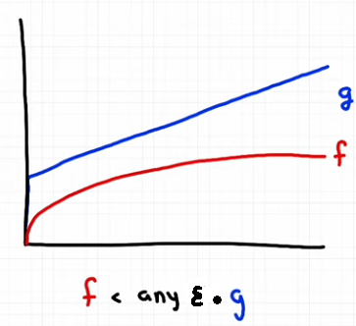
Formal Definition of Little o
Suppose f(n) and g(n) are two functions. f(n)=o(g(n)) if and only if for every positive constant ε there exist constant k that f(n) < ε g(n) for all n ≥ k
Little o is used to describe that one function grows significantly slower than another as the input size approaches infinity.
Big O means “f is of the same order as g”.
Little o means “f is ultimately smaller than g”.

Slide 7
Example of little o application
Little o notation is useful for refining performance analysis, particularly when we need to indicate that certain terms in an algorithm's runtime become negligible as the input size grows.
Example: Suppose an algorithm's runtime is T(n)=n + o(n)
This means the algorithm takes n steps as the dominant factor, and the rest of the operations grow slower than n, becoming negligible for large n.

Slide 8
Example
What is the little o for f(n) = n?
For any ε > 0, there exists a constant k such that n < εn² for all k ≤ n.
o(n²)

Slide 9
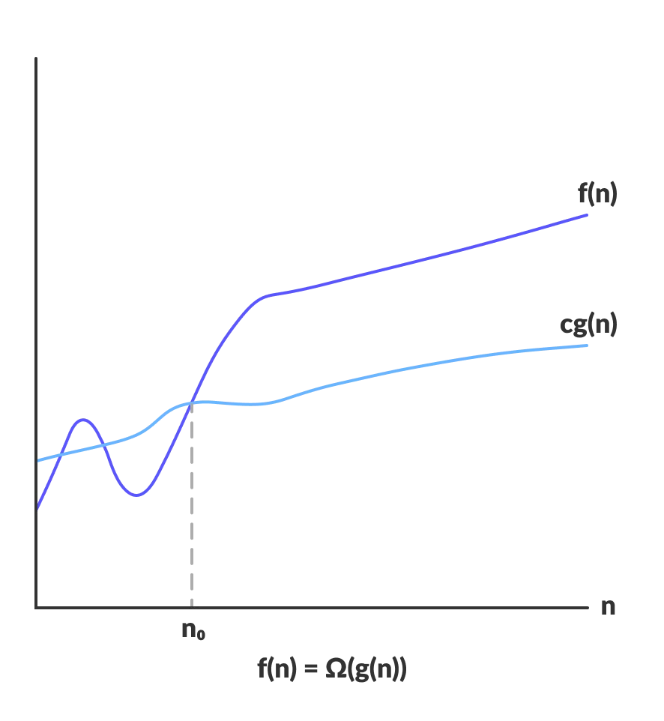
Formal Definition of Omega (Ω)
Suppose f(n) and g(n) are two functions. f(n)= Ω(g(n)) if and only if there exist constants k and c that cg(n) ≤ f(n) for all n≥k
We can say that f(n) is at most as good as g(n).
k

Slide 10
Examples of Ω
Is 5n² ϵ Ω(n²)?
Assume c=1 and k=0, then we have: 5n² ≥ 1n² for n>0
Is n² + 10n ϵ Ω(n²)?
Assume c=1 and k=0, then we have: n² + 10n ≥ 1n² for n>0
Is n(n-1)/2 ϵ Ω(n²)?
Assume c=0.1 and k=2 then: n(n-1)/2 ≥ 0.1 n² for n>2
Is n³ϵ Ω(n²)?
Yes! Assume c=1 and k=0 then: n³ ≥ 1n² for n>0

Slide 11
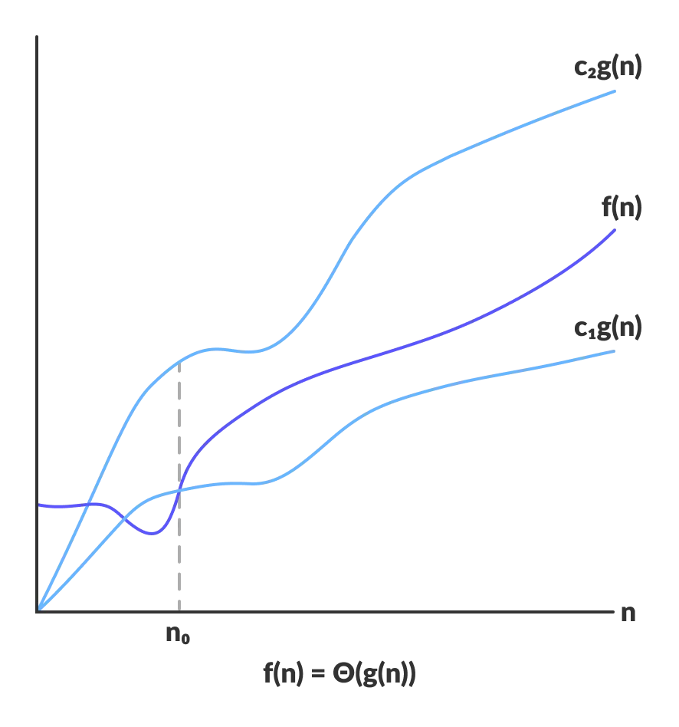
Formal Definition of Theta (Θ)
Suppose f(n) and g(n) are two functions. f(n)= Θ(g(n)) if and only if f(n)=O(g(n)) and f(n)= Ω(g(n))
k

Slide 12
Example
If f(n) has both O(n²) and Ω(n²), it means that it’s complexity:
Is better (i.e., lower) than some n² functions
Is worse (i.e., higher) than some other n² functions
We can conclude that f(n) growth is “similar” to n² functions (Θ(n² ))

Slide 13
More Examples
Θ(n²)
3logn + 8
4n²
4n²
4n³ + 3n²
5n + 7
6n² + 9
6n² + 9
6n⁶ + n⁴
2n + logn
5n² + 2n
5n² + 2n
2^{n} + 4n
O(n²)
∩
Ω(n²)
Θ(n²) =

Slide 14
Graphical Presentation of O, Ω, and Θ
k
k
k

Slide 15
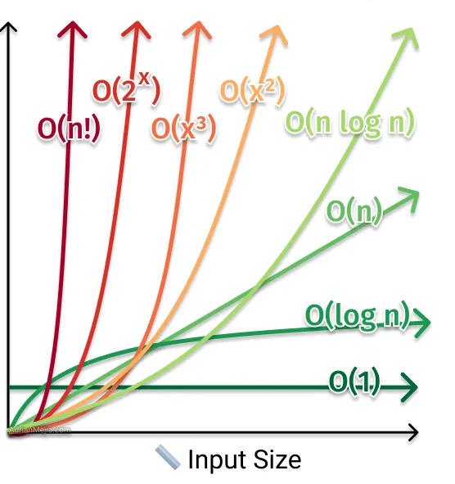
Pre-defined Complexity Classes
There are pre-defined orders of complexity:
O(log n) < O(n) < O(nlogn) < O(n²) < O(n³) < O(2^{n}) <O(n!)
In general, complexities up to O(nlogn) are acceptable. Even higher orders can work for problems up to a certain size.
Approximate number of times basic operations are executed

Slide 16
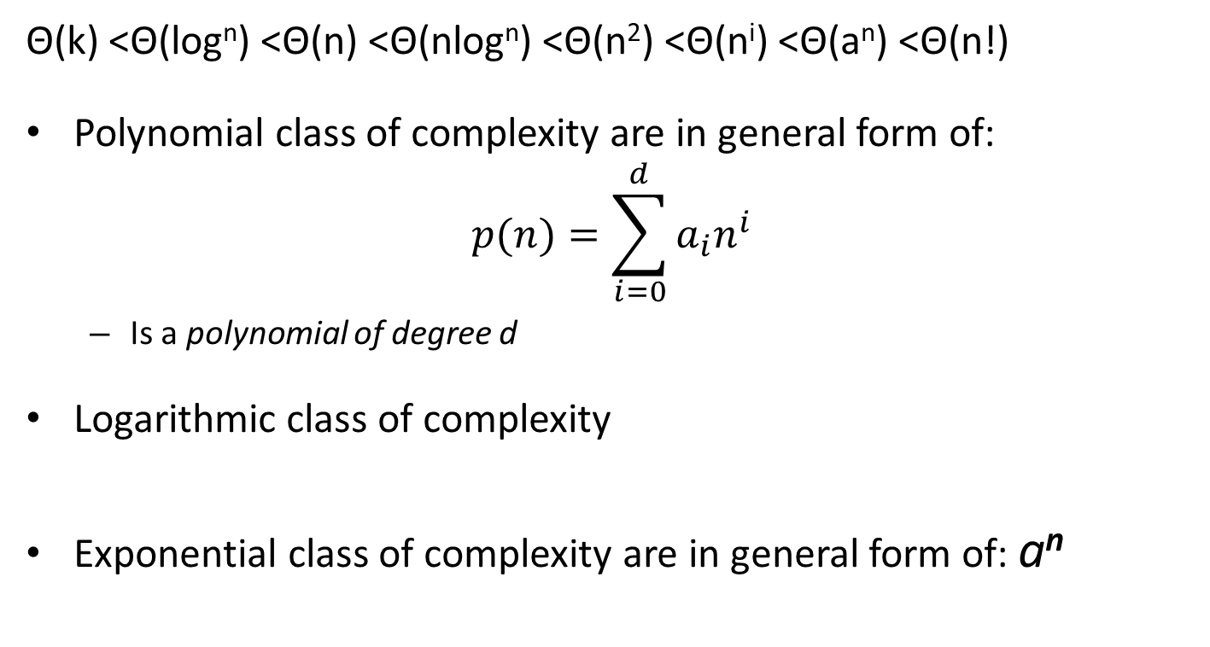
Remember These Complexity Classes
Θ(k) <Θ(log^{n}) <Θ(n) <Θ(nlog^{n}) <Θ(n²) <Θ(n^{i}) <Θ(a^{n}) <Θ(n!)
Polynomial class of complexity are in general form of: $p(n)=\sum_{i=0}^{d}{a_{i}n^{i}}$
Is a polynomial of degree d
Logarithmic class of complexity
Exponential class of complexity are in general form of: a^{n}

Slide 17
Properties of Orders
g(n) ϵ O(f(n)) if and only if: f(n) ϵ Ω(g(n))
All logarithmic complexity functions are in the same class:
For a>1 and b>1 we have log_{a}n ϵ Θ(log_{b}n)

